Slide 1


Slide 2

Tutorial 6 Sections 009/010
TA: Greydon Gilmore
Physiology 2130
Oct 15th, 2019

Slide 3

Your TA reminding you…
1st Peerwise assignment (1.5%)
Post 2 MC questions: due Oct 16th @ midnight (Tomorrow!)
Answer 5 MC questions: due Oct 18th @ midnight
38 students wrote 2 MC Q’s
43 students answered 5 MC Q’s
1st Quiz (1%)
Opens: Oct 21st @ 4pm
Closes: Oct 22nd @ 4pm
1st Midterm - Oct 25th @ 6pm-7pm (15%)
Midterm Review session
When: Tuesday, Oct 22nd from 6:00-8:00pm
Where: Auditorium B, University Hospital, 3rd floor

Slide 4
Today
No group work!
Learning Catalytics Question
Vision
Audition
Motor Control

Slide 5
Question from anonymous suggestion box…

Slide 6
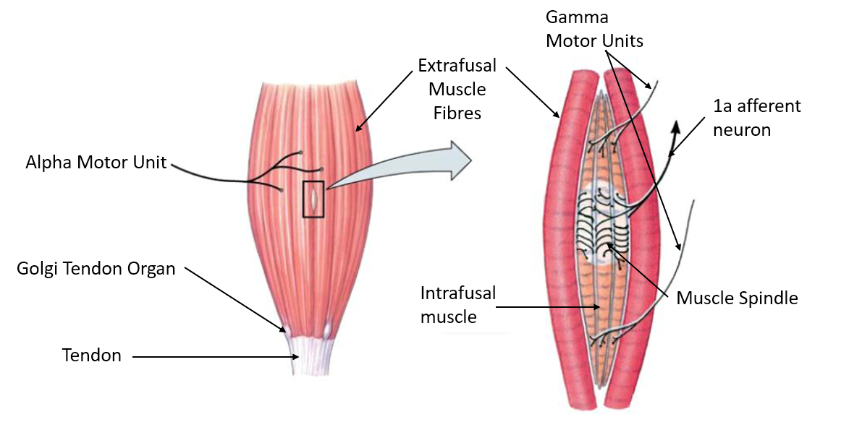
How do gamma neurons regulate gain of muscle spindles, and how does the inhibitory inter-neuron in the antagonistic patellar tendon reflex work?
Extrafusal fibers: normal contractile fibers, outer muscle
Alpha motor neuron innervates extrafusal muscle fibers
Intrafusal fibers: internal muscle fibers of muscle
Gamma motor neurons innervate intrafusal fibers.

Slide 7
How do gamma neurons regulate gain of muscle spindles, and how does the inhibitory inter-neuron in the antagonistic patellar tendon reflex work?
Stretching of muscle spindle/intrafusal muscle fiber
Info sent from muscle spindles to CNS via 1a afferent neurons
CNS processes info
Alpha motor neuron causes extrafusal muscle fiber contraction
Gamma motor neuron causes intrafusal fiber contraction

Slide 8
Learning Catalytic Question

Slide 9
Vision: Eye and Retina
Chapter 2: Dr. Everling
pp.

Slide 10
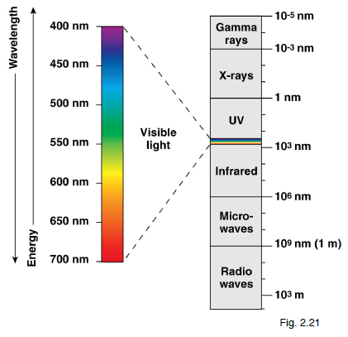
Electromagnetic Spectrum
Light is electromagnetic energy emitted in the forms of waves
Our eyes are sensitive to a small part of this spectrum called visible light (400 –700 nm)

Slide 11
The first structure which the majority of retinal ganglion cells project to, and synapse with, in the brain is the…
Visual cortex
Optic chiasm
Lateral geniculate nucleus
Superior colliculus

Slide 12
The first structure which the majority of retinal ganglion cells project to, and synapse with, in the brain is the…
Visual cortex
Optic chiasm
Lateral geniculate nucleus
Superior colliculus

Slide 13
Components of the Visual system
Fundamental Components:
Eye →Retina →Optic Nerve →Optic Chiasm →Optic Tract →LGN →Optic Radiations →Primary Visual Cortex
Retinal Targets:
Lateral geniculate nucleus (LGN)
Main target (90% of info)

Slide 14
Eye (Gross Anatomy)
Pathway of light:
Cornea →Anterior Chamber (with aqueous humor) →Pupil →Lens →Posterior Chamber (with vitreous humor) →Retina
Other important Structures:
Iris
Sclera
Conjuctiva
Extraocular Eye Muscles
Ciliary Muscles
Fovea
Optic disk (Blindspot)

Slide 15
Eye (Gross Anatomy)
Optic disk
(blind spot)
Fovea
Temporal Retina
Nasal Retina
Nasal Retina
Temporal Retina
Right Eye
Macula
Left Eye

Slide 16
Retinal Cells
Main Pathway:
Photoreceptors (rods and cones)
Bipolar cells
Ganglion cells
Modulation and Communication:
Horizontal cells
Amacrine cells

Slide 17
Retinal Layers
Nuclear layers: cell bodies
Plexiform layers: synapses
Ganglion cell layer
Inner plexiform layer
Inner nuclear layer
Outer plexiform layer
Outer nuclear layer
Photoreceptor outer segments

Slide 18
The fovea is the part of the retina that contains photoreceptors called…
Rods
Ganglion cells
Cones
Amacrine cells

Slide 19
The fovea is the part of the retina that contains photoreceptors called…
Rods
Ganglion cells
Cones
Amacrine cells

Slide 20
Photoreceptors
Two parts:
Outer segment: photosensitive part
Inner segment: cell body

Slide 21
Two Photoreceptors: Rods vs. Cones
Feature | Rods | Cones
Sensitive to… | White/Black | Color
Lighting conditions… | Dim light | Daylight
Located | Around retina | Only in fovea
Amount | Many (120 million/retina) | Few (5 million/retina)

Slide 22
Axons extending from the nasal part of the retina project to the ______ side of the brain, whereas axons from the remainder of the retina project to the ______ part of the brain.
Dorsal, ventral
Opposite (contralateral), same side (ipsilateral)
Same side (ipsilateral), opposite (contralateral)
Medial, Lateral

Slide 23
Axons extending from the nasal part of the retina project to the ______ side of the brain, whereas axons from the remainder of the retina project to the ______ part of the brain.
Dorsal, ventral
Opposite (contralateral), same side (ipsilateral)
Same side (ipsilateral), opposite (contralateral)
Medial, Lateral

Slide 24
Visual Field
KEY POINTS TO REMEMBER:
Info from each visual field is sent to OPPOSITE side of each retina
Info from each visual field is sent to CONTRALATERAL hemisphere
Temporal retina axons DO NOT cross optic chiasm
Nasal retina axons DO cross optic chiasm
Temporal
Nasal
Optic radiation

Slide 25
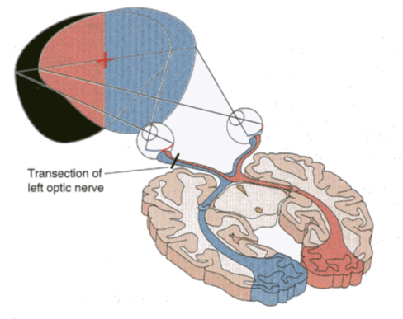
Visual Pathway: Lesion at Optic Nerve
Left optic nerve lesion
See only visual field of right eye (same as closing left eye)
Right optic nerve lesion
See only visual field of left eye (same as closing right eye)

Slide 26
Visual Pathway: Lesion at Optic Chiasm
Lesion at optic chiasm
Tunnel Vision (i.e. lose nasal retina axons, which carried info from peripheral vision)

Slide 27
Visual Pathway: Lesion at Optic Tract
Left optic tract lesion
See only left hemifield (i.e. lose right hemifield)
Right optic tract lesion
See only right hemifield (i.e. lose left hemifield)

Slide 28
Sensory: Auditory System
Chapter 2: Dr. Everling
pp.

Slide 29
Sound
Sound is variations in air pressure
Intensity (Loudness): difference in pressure between compressed air patches (amplitude)
Measured in Decibels (dB)
Frequency (Pitch): # of compressed air patches
Measured in Hertz (Hz): # of cycles/second
Human frequency range: 20 – 20000 Hz
Most sensitive range: 2000 – 4000 Hz

Slide 30
Pinna is a shell-like structure which is a part of:
Inner ear
Outer ear
Middle ear
None of the above

Slide 31
Pinna is a shell-like structure which is a part of:
Inner ear
Outer ear
Middle ear
None of the above

Slide 32
Divisions of Auditory System
Outer Ear: AIR
Auricle (Pinna)
Auditory Canal: enhances intensity by resonance (reflection of sound waves in closed tube enhances intensity of certain frequencies)
Middle Ear: AIR
Tympanic Membrane (Eardrum): transmits sound from air to ossicles
3 Ossicles: Malleus, Incus and Stapes: convert air pressure changes to mechanical pressure
Auditory (Eustachian) Tube: important in changing air pressure
Inner Ear: FLUID
Cochlea: convert fluid vibrations into electrochemical impulses carried to brain

Slide 33
Cochlea
Two windows
Oval Window: connected to stapes; transfers vibrations to perilymph fluid
Round Window: counterbalances movement of oval window

Slide 34
The receptors in the Organ of Corti are hair cells. How are they stimulated?
By air-borne waves
Displacement of the vestibular membrane
Displacement of tectorial membrane
Displacement of basilar membrane

Slide 35
The receptors in the Organ of Corti are hair cells. How are they stimulated?
By air-borne waves
Displacement of the vestibular membrane
Displacement of tectorial membrane
Displacement of basilar membrane

Slide 36
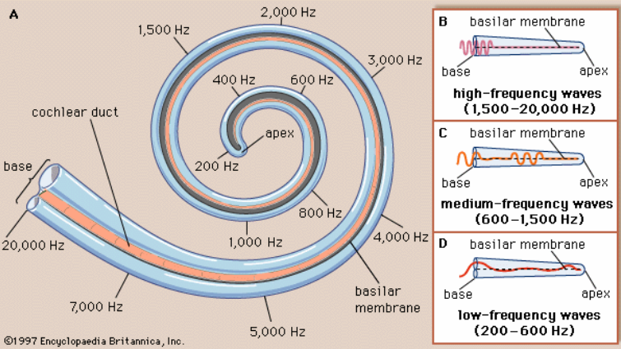
Cochlea
Tonotopic map
Cochlea shows an orderly map of frequencies along its length
Base: narrow and stiff; detects high frequency
Apex: wide and floppy; detects low frequency

Slide 37
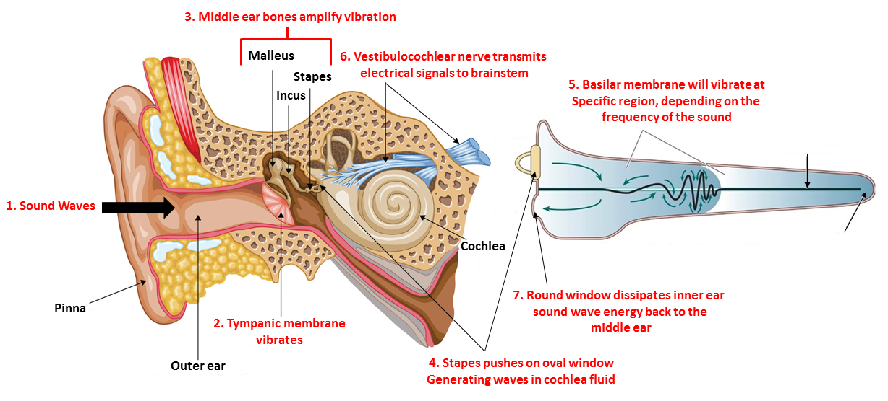
How Sound Travels Through Ear

Slide 38
Divisions of Auditory System
Organ of Corti contains hair cells with stereocilia:
Fluid movements cause deflection of basilar membrane
Basilar membrane deflection leads to dragging of hair cells against the tectorial membrane
Stereocilia bend from dragging
Hair cells depolarize when stereocilia bend
Mechanically-linked ion channels open (depolarization)
Aka brings cell to threshold → AP is fired
When hair cells bend in other direction the cell is hyperpolarized

Slide 39
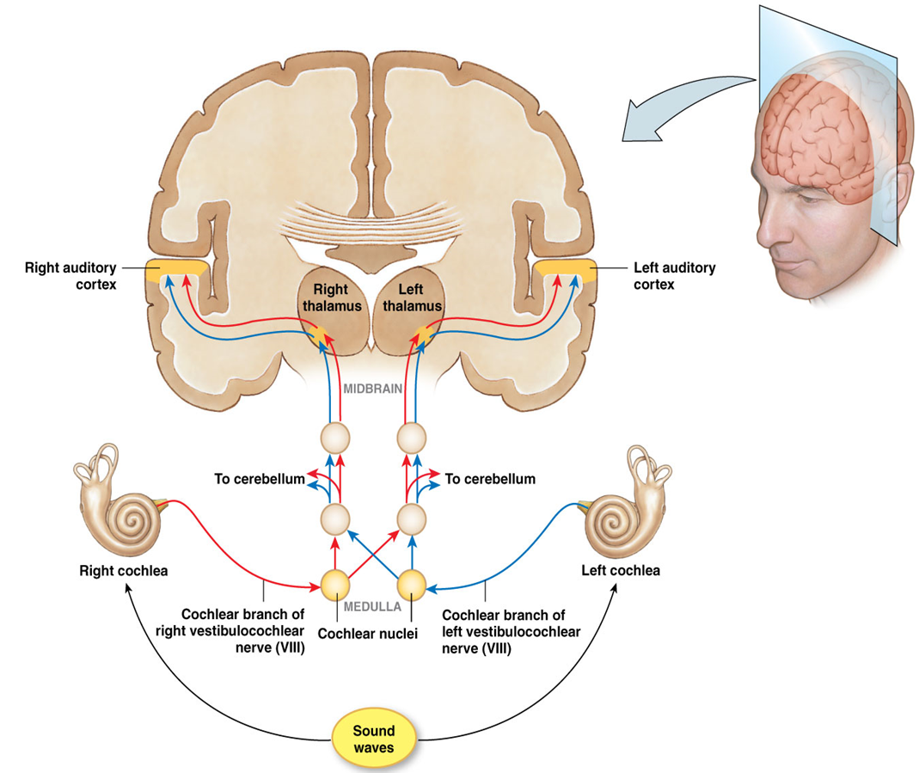
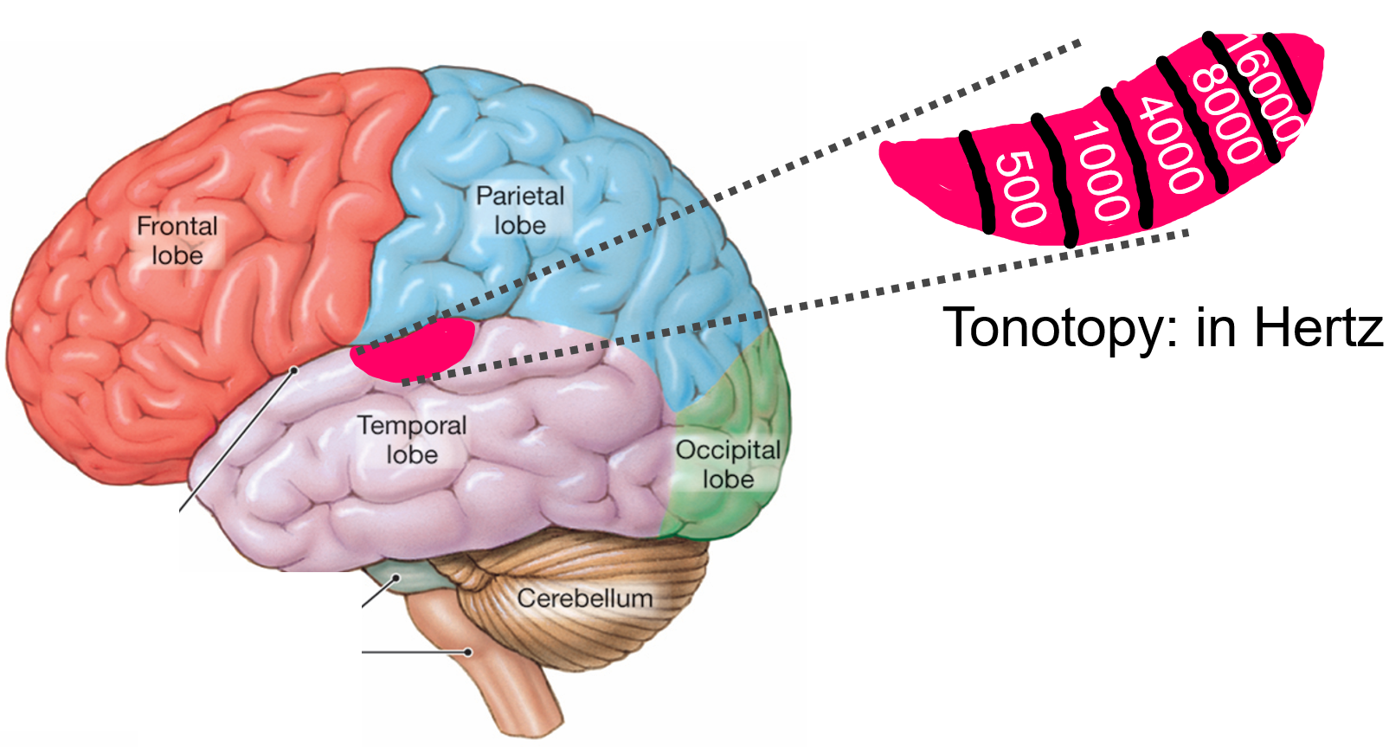
Auditory Pathway
Auditory Nerve (Vestibulocochlear nerve)
Formed by axons of spiral ganglion cells
Medulla
Info from right and left ears combine
Midbrain
Projections to cerebellum
Primary Auditory Cortex (Temporal Lobe)
Tonotonic Map:
Anterior: Low frequencies
Posterior: High frequencies

Slide 40
Hearing Loss
Conductive: Sound is unable to be transmitted through outer or middle ear.
A mechanical defect
e.g. Extremely loud sounds rupture eardrum or damaged ossicles
Sensorineural: damage to structures of inner ear that affects hair cells, or to auditory nerve (nerve deafness)
e.g. Extremely loud sounds damage Organ of Corti
e.g. Presbycusis (old + hearing), i.e. degenerations in the cochlea
Central: Damage to auditory pathways upstream from cochlea
A defect in the Central Nervous system
e.g. tumours or strokes in the central auditory pathways

Slide 41
Motor Physiology
Chapter 3: Dr. Everling
pp.

Slide 42
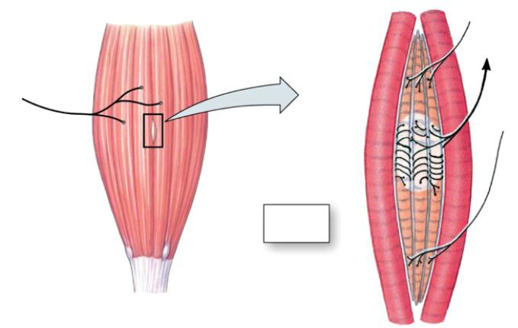
Muscle Anatomy
Gamma Motor Units
Extrafusal Muscle Fibres
1a afferent neuron
Alpha Motor Unit
Golgi Tendon Organ
Intrafusal muscle
Muscle Spindle
Tendon

Slide 43
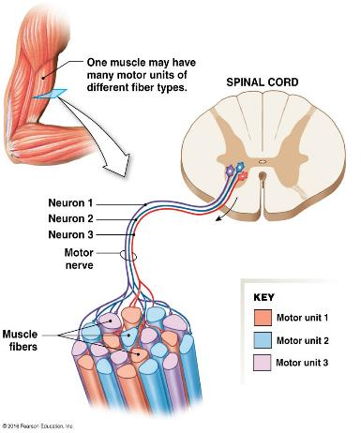
Motor Unit/Pool
Motor Unit: Group of skeletal muscle fibers and the 1 somatic motor neuron that controls them
Motor Neuron Pool: group of motor neurons that innervate a single muscle

Slide 44
Muscle Spindle
Stretching of muscle spindle/intrafusal muscle fiber
Info sent from muscle spindles to CNS via 1a afferent neurons
CNS processes info
Alpha motor neuron causes extrafusal muscle fiber contraction
Gamma motor neuron causes intrafusal fiber contraction

Slide 45
Golgi Tendon Organ
Golgi tendon organ links muscle and tendon
Collagen fibers woven around sensory receptors
Increase in tension causes collagen contraction around sensory receptor, which sends info to CNS via 1b afferent neuron

Slide 46
Reflexes
Reflex: involuntary response to a stimulus which requires the integrity of the nervous system
Reflex arc involves: Receptor →Afferent neuron →Synapse →Motor neuron → Effector
Monosynaptic reflex: Pathway in a reflex arc that contains only 1 synapse (ex: stretch reflex)
Polysynaptic reflex: Pathway in a reflex arc that contains more than 1 synapse (ex: withdrawal reflex)
Reciprocal Innervation: Contraction of a muscle is accompanied by simultaneous inhibition of antagonistic muscle

Slide 47
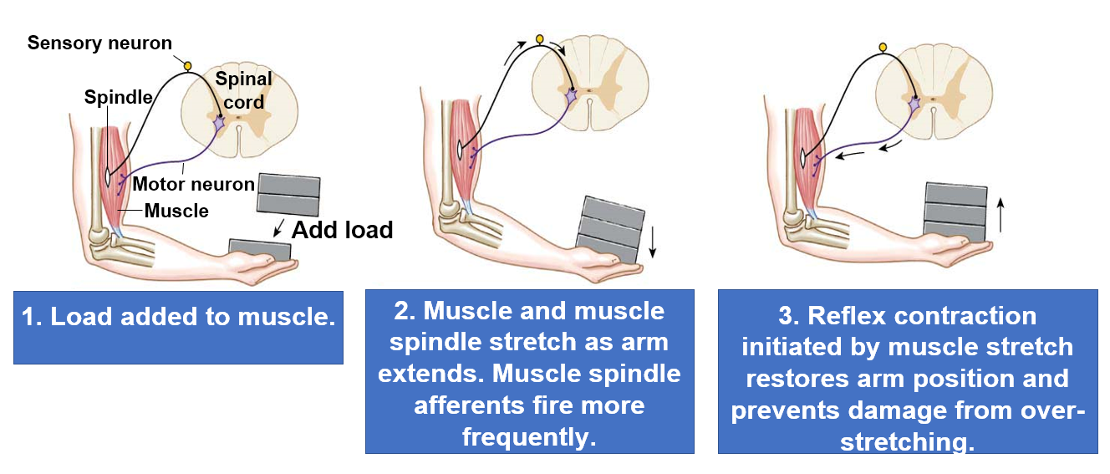
Stretch Reflex

Slide 48
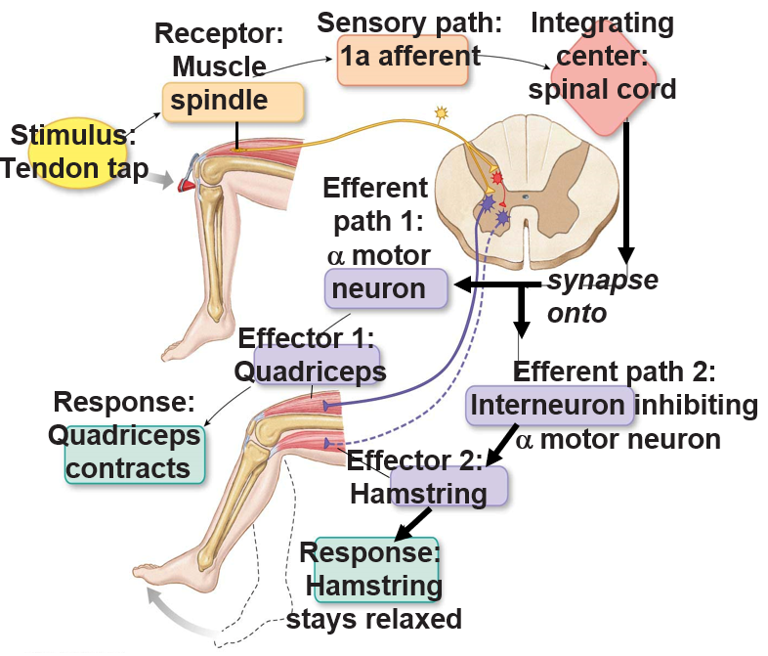
Patellar Tendon Reflex
Tapping patellar tendon stretches quadriceps femoris (extensor muscle)
Muscle spindle in quadriceps femoris stretches, activating 1a afferent to fire action potentials.
1a afferent directly synapses (monosynaptic) on alpha motor neuron to quadriceps femoris – muscle contracts and lower leg swings forward.
Collateral from the 1a afferent also excites an inhibitory interneuron in the spinal cord.
Inhibitory interneuron inhibits alpha motor neuron to antagonistic (Hamstring) muscle. The hamstring is a flexor muscle.
Antagonistic muscle relaxes (reciprocal innervation (inhibition) so leg can extend and swing out.

Slide 49
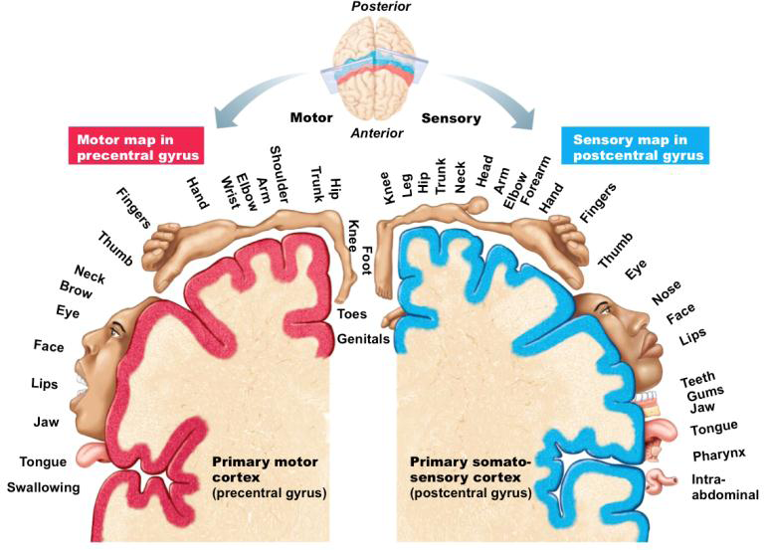
Motor Cortex, Homunculus vs. Somatosensory Cortex
Motor homunculus: Found in primary motor cortex, which is precentral gyrus
Sensory homunculus: Found in somatosensory cortex, which is postcentral gyrus

Slide 50
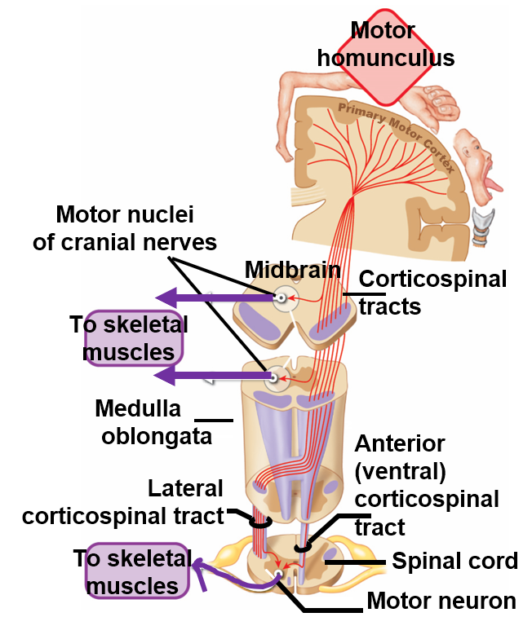
Corticospinal Tracts
Corticospinal pathway (pyramidal tract) is the primary pathway that leaves the motor cortex to innervate motor neurons in the spinal cord
Left side of body controlled by right motor cortex
Axons cross at brain stem or spinal cord

Slide 51
Next Tutorial (Oct 22nd)
Endocrinology

Slide 52
What Questions Do You Have?
You can ask in the Owl forums as well!
Also anonymously ask questions in the online dropbox!!

